Slide 1

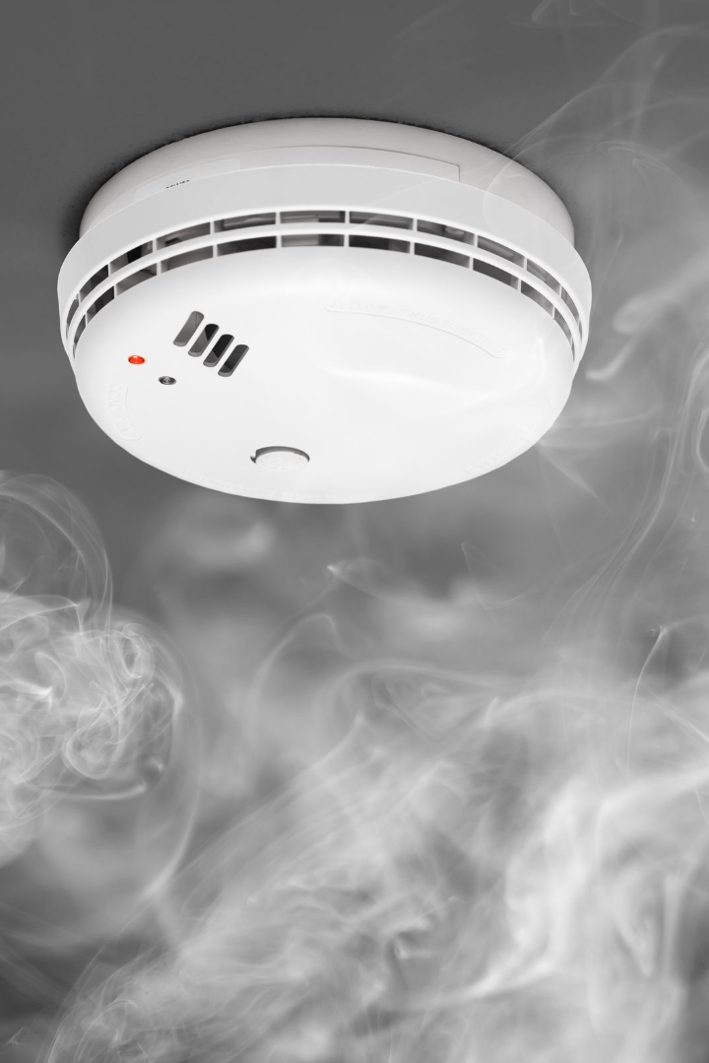
Fire & Smoke Detection and Alert System
Abu Mukaddim Rahi ID: 2022027042
Amrina Afroz ID:171259042
Abu Sufiun ID:1831274642
Abdullah Almoon ID:1922223642

Slide 2

Introduction
What is the project?
The fire & smoke detection and alert system is an advanced technology designed to detect the presence of fire and smoke in residential and commercial spaces. It provides early warning signals to occupants, allowing swift action to prevent property damage and ensure safety.
What is the problem?
Fire detection plays a crucial and significant role in saving societies and possessions. A fire detection system is able to realty reduce damages and increase the effort to control fire related incidents. Due to the considerable variation in hue and texture, detecting smoke and fire from visual sceneries is a difficult task. Several classifications of smoke and fire images. To address this issue, various ways have been presented. However, the majority of them rely on either rule-based or algorithm-based solutions.

Slide 3
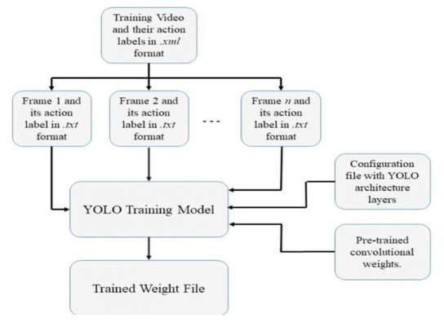
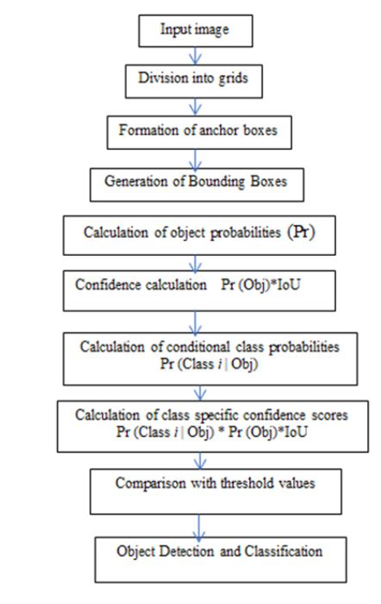
Design
To solve this project we are using YOLOv8 algorithm. YOLOv8 is a highly efficient algorithm that incorporates image classification, Anchor-Free object detection, and instance segmentation. Its detection component incorporates numerous state-of-the-art YOLO algorithms to achieve new levels of performance

Slide 4
Economic, Social, Political, and Health Impact
Economic Impact
Social Impact
Political Impact
Health Impact
The implementation of fire and smoke detection systems can help prevent devastating property losses, reducing the economic burden on individuals, businesses, and insurance companies.
By enhancing safety measures, these systems help protect lives, providing peace of mind for occupants and their families.
Government regulations and policies often require the installation of fire and smoke detection systems in public buildings, ensuring compliance with safety standards.
The early detection and prevention of fire and smoke can significantly reduce the risk of injuries and fatalities caused by fires, promoting a healthier and safer environment.

Slide 5

Ethical & Professional Responsibility
1
Ensuring Safety
By installing and maintaining fire and smoke detection systems, individuals and organizations fulfill their ethical and professional responsibilities to prioritize the safety and well-being of occupants.
2
Continuous Monitoring
Regular inspections, testing, and maintenance of the system ensure its reliability and effectiveness, avoiding potential ethical and legal implications arising from negligence.
3
Data Privacy
Proper handling of data collected by the system is crucial to respect privacy rights and maintain ethical standards in storing and processing sensitive information.

Slide 6

Tools & Technologies Used
Smoke Detectors
Photoelectric and ionization smoke detectors are commonly used to detect the presence of smoke particles, triggering alarms.
Heat Detectors
Heat detectors sense rapid increases in temperature, suitable for environments with high levels of dust or fumes that may interfere with smoke detectors.
Sprinkler Systems
Automatic fire sprinkler systems work in conjunction with the detection system, providing fire suppression measures, minimizing damage, and aiding occupant evacuation.

Slide 7
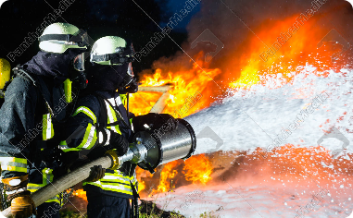
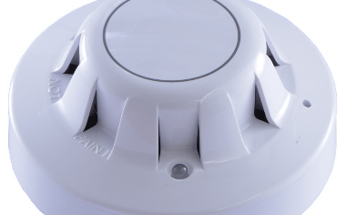

Results
Rapid Fire Containment
Early Warning System
Timely Notifications
Notifications are sent to relevant parties, including occupants, facility managers, and emergency responders, ensuring a coordinated and efficient response.
With the fire and smoke detection system, fires can be quickly contained, minimizing damage and reducing the risk to life and property.
The system provides early warning signals, allowing occupants to take immediate action, evacuate if necessary, and notify emergency services.

Slide 8
Results (Contd.)
1
Data selection
For our project focused on developing smoke and fire detection systems, we will be obtaining a video from YouTube depicting a plane crash scenario where both smoke and fire are present.
2
Preparing Dataset
I use Roboflow for preparing the dataset. Upload the random video to my Roboflow workspace. Then do Frame Extraction after that did labeling for all images.
3
Training
Then I YOLOv8 to train the model on my labeled dataset. After training, evaluate the model's performance on the validation and test sets. We are not satisfied with the model's performance because of our dataset because we have small number of images so we need to increase this.
4
Future Plan
First of all we want to increase our dataset to 10K images, so we started collecting videos.
To enhance the system's capabilities, future plans include exploring methods to detect the presence of people amidst smoke or fire. This would further improve evacuation efforts and enable emergency responders to better locate and assist individuals in need. Additionally, ongoing research and development will focus on implementing advanced technologies and machine learning algorithms to continuously enhance the system's effectiveness and accuracy.

